Slide 1
Applying NLP Models for the Prediction of siRNA Sequences Based on DNA
Mica Haney, Camrie Johnson

Slide 2
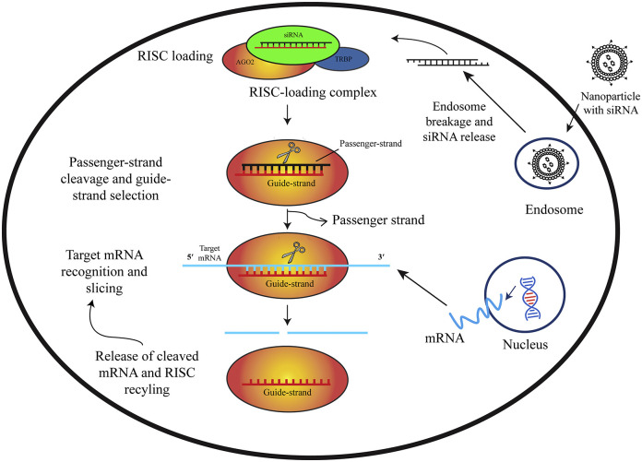
What are siRNAs?
Small interfering RNA (siRNAs)
Non-coding RNAs that can regulate gene expression by binding to complementary mRNA sequences
Can silence genes associated with disease

Slide 3
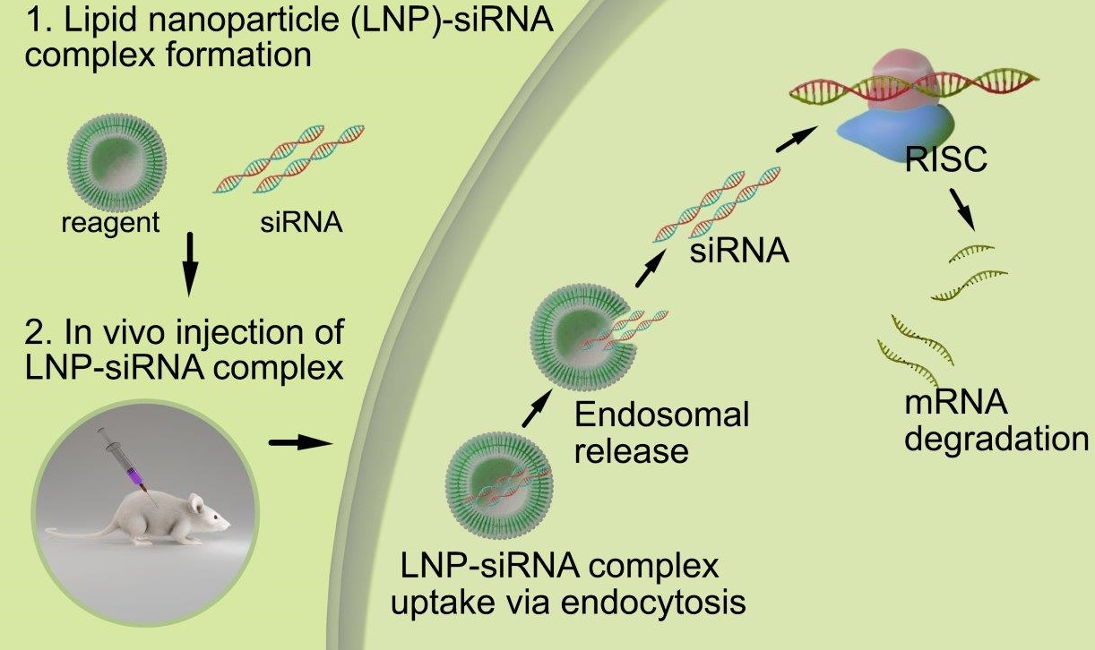
Applications and Challenges of siRNA Design
Applications:
Brain diseases such as Alzheimer’s
Cancers
Viral infections such as COVID
Challenges:
Off target silencing effects
Low stability and targeting
Delivery to target cells

Slide 4
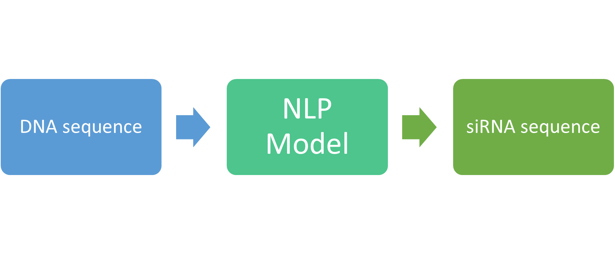
Project Objective
Use NLP models to generate siRNA sequences that bind to specific sites of a gene to inhibit the expression of that segment of the gene.

Slide 5
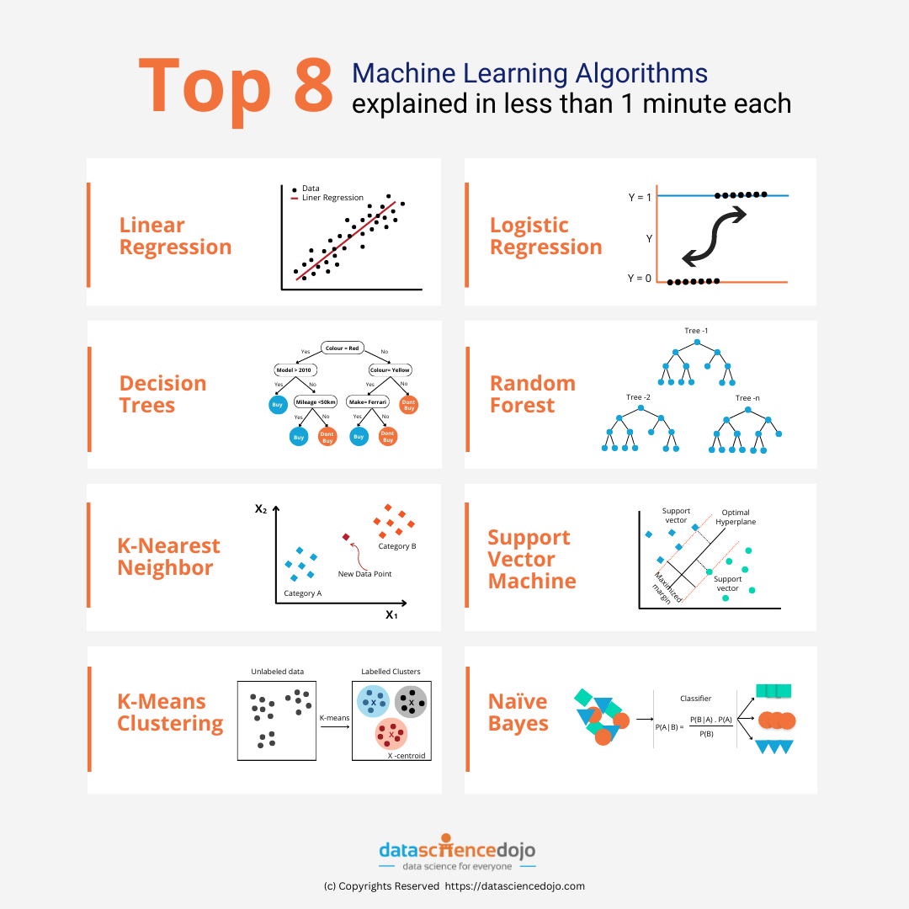
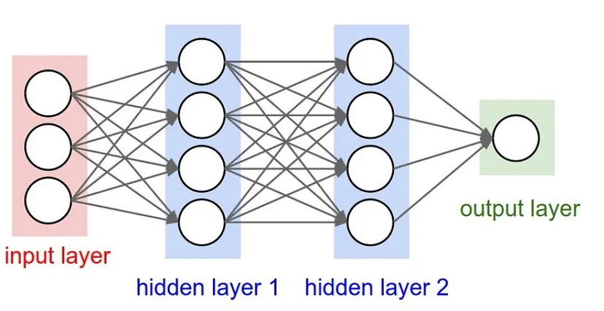
Machine Learning (ML)
ML is a branch of programming where computer models adapt to data without specific direction by using statistics.
Shallow ML: ML models that do not use layers.
Deep ML: ML models that use layers.

Slide 6
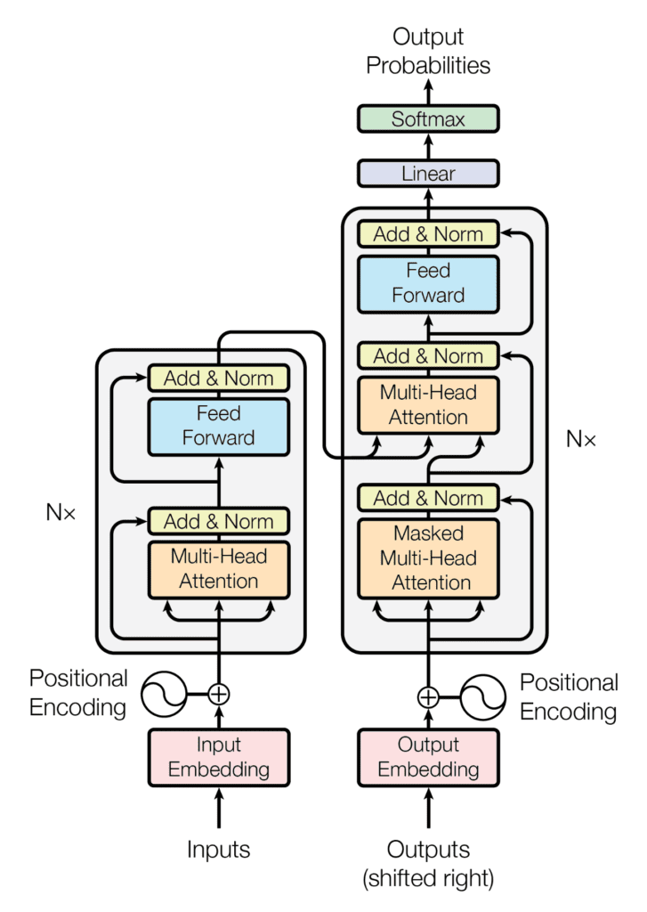
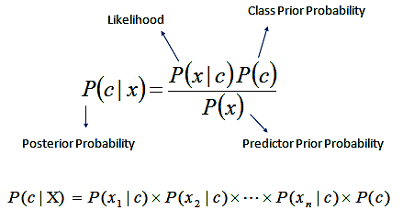
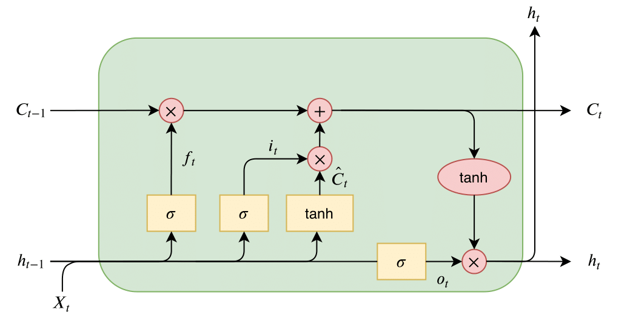
Selected Model Architectures
Naive Bayes: Shallow learning model based on prior probabilities.
LSTM: Sequential model for working with series data.
Transformer: Attention based model developed for NLP tasks.

Slide 7
Metrics
Hamming Distance: Collected min, max, and average hamming distances.
BLEU: Measures how many bases that the model generates are in the target sequence.
ROUGE: Measures how many bases in the target sequence appear in the generated sequence. There are multiple versions based on specific n-gram counts.
Both BLEU and ROUGE have ranges of 0 to 1.

Slide 8
Dataset
Obtained from Kaggle
Contains the following from 14 different papers
siRNA sequences
Target genes
Positions in target gene
650 data entries, only 608 used

Slide 9
Preprocessing General
Three datasets were created from the original dataset each containing:
All of the target genes, binding locations, and siRNA sequences.
The features in (1) where only records with high activity (over 70%) were kept.
The features in (1) as well as some additional numerical features. These values were scaled to be between 0 and 1 and appended onto the end of rows.
Dif_5-3 (Energy difference between 5’ and 3’ end)
A, C, G, U content
Cons_Sum (Nucleotide position dependent consensus summary)
For all sequences a start and end character were added as appropriate.

Slide 10
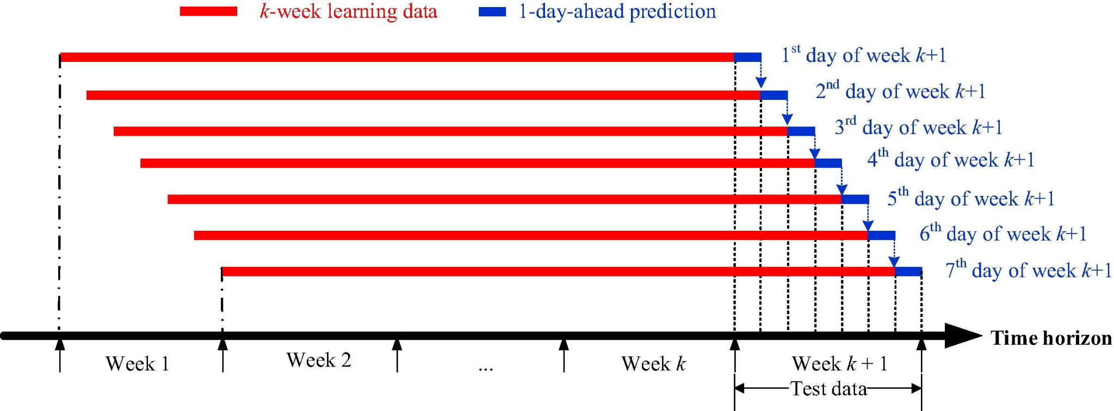
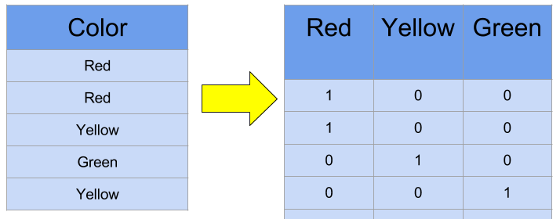
Preprocessing Naive Bayes
For each gene/siRNA pair, the gene was windowed to create a subsequence of the gene per base in the siRNA. Each window was one-hot encoded.
A window size of 5 was used.

Slide 11
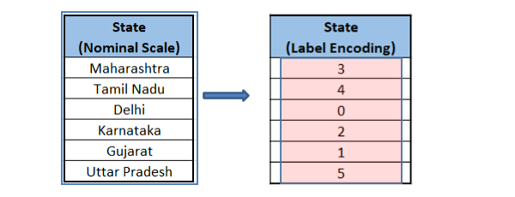
Preprocessing LSTM and Transformer
For each gene/siRNA pair, the section of the gene that the siRNA binds to was taken and both the gene subsequence and siRNA were numerically encoded.

Slide 12

Training
For all models, 5-fold cross validation was performed due to the low data amount.
For the LSTM and transformer, each batch trained for 10 epochs with batch sizes of 20.
The LSTM and Transformer both had hidden unit sizes of 256 and dropout rates of 0.1.
The Transformer has 2 layers to the encoder/decoder stack and 4 attention heads.
The Transformer had embedding sizes of 128.

Slide 13
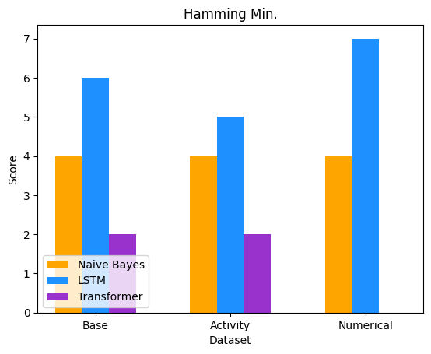
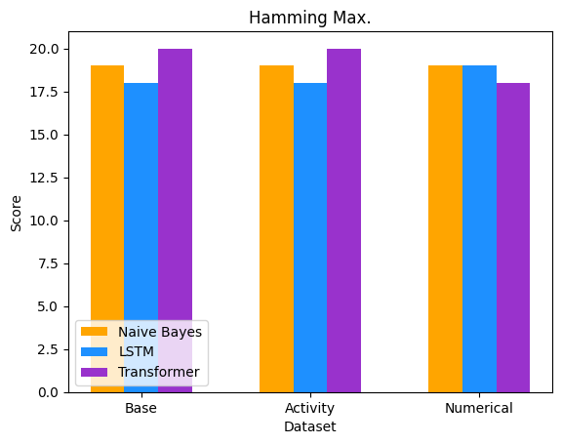
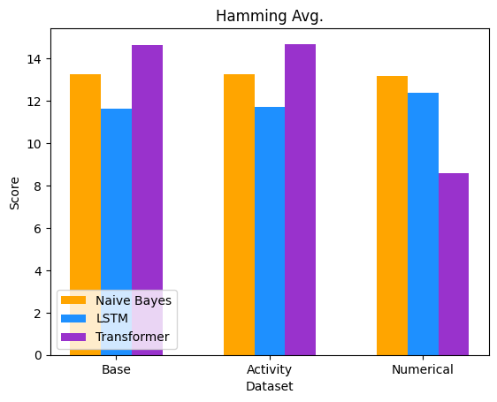
Results Hamming Distances

Slide 14
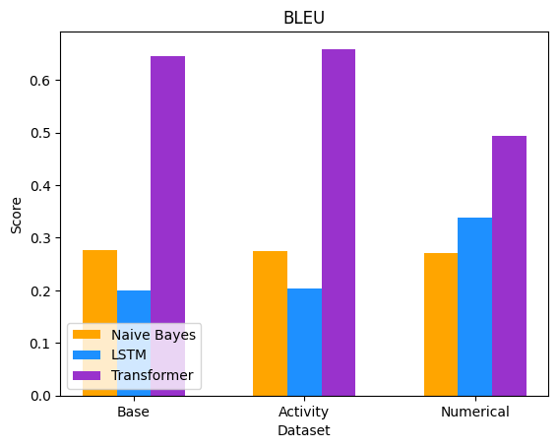
Results BLEU

Slide 15
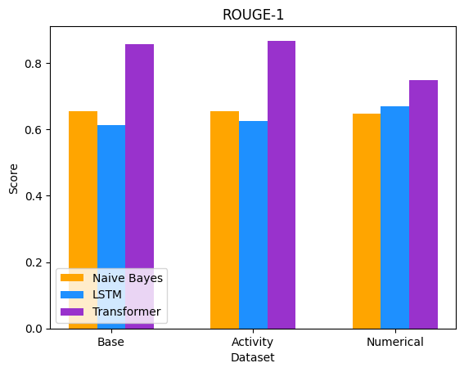
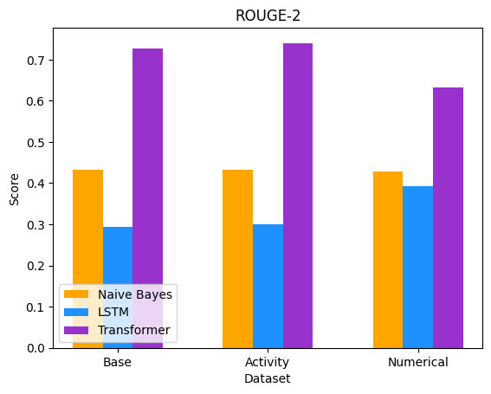
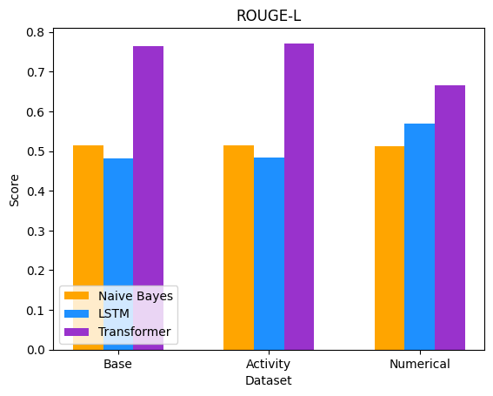
Results ROUGE

Slide 16
Conclusion and Discussion
Main findings:
Transformer model was overall the most accurate model
Broader Impact:
NLP models can be applied effectively predict siRNA sequences
Could lead to treatments and therapies that traditional models would not discover
Limitations:
Not enough data
Time constraints (could not implement transfer learning with miRNA)

Slide 17
Questions?

Slide 18
References (Images)
https://www.sciencedirect.com/science/article/pii/S088875432032067X?via%3Dihub
https://altogen.com/transfection-resource/in-vivo-sirna-transfection/
https://thorirmar.com/post/insight_into_lstm/
https://towardsdatascience.com/building-a-deep-learning-model-using-keras-1548ca149d37
https://www.google.com/url?sa=i&url=https%3A%2F%2Fdatasciencedojo.com%2Fblog%2Fmachine-learning-algorithms-explanation%2F&psig=AOvVaw1wzQf0APjIjdQ_uOQPKLLK&ust=1701709712088000&source=images&cd=vfe&opi=89978449&ved=2ahUKEwjV-bvo4POCAxWp2MkDHXAmDcAQr4kDegUIARCNAQ
https://afit-r.github.io/naive_bayes
https://machinelearningmastery.com/the-transformer-model/
https://www.sciencedirect.com/science/article/pii/S0306261916306717
https://www.kaggle.com/code/dansbecker/using-categorical-data-with-one-hot-encoding
https://www.mygreatlearning.com/blog/label-encoding-in-python/
https://scikit-learn.org/stable/modules/cross_validation.html

